Slide 1

Business plan of PDL business in China Prepared by APAC team
27.09.2016

Slide 2
Table of contents
1 | Investment summary | 3-4
2 | Market overview | 5-6
3 | Legal | 7-16
4 | Product and Business Processes | 17-24
5 | Marketing | 25-33
6 | Risk Management | 34-40
8 | IT | 41-42
9 | Finance | 43-50
10 | Project Plan | 51
11 | Appendices | 52-63

Slide 3
1. Investment summary
Chinese Money Lending Market is one of the most promising in Asia due to a number of factors:
Huge population: over 1.37Bn with average monthly income of $730 for the employed part, high figure when compared to other Asian markets
Well-developed infrastructure for online business model: bank account penetration at 79%, smartphone penetration at 58%, remote contract signing possible, interest rate cap regulation is not tight
Majority of formal FS players (banks, finance companies) focus on products for upper- and middle-class customer segments (usually with large ticket size and often secured), so a significant portion of population is not covered by formal financial services, especially in Tier 2-4 cities (with total population of 595 mln.)
Regulatory environment allows us to operate in this market with relatively low capital requirements and via a variety of legal setup options
There are several (5-10) competitors who use the same “pure online” business model, but only one company claims to provide loans within 1 hour (“CashBus”). Average Time-to-money (TTM) for other online moneylenders is 1-3 working days
We believe positive results can be achieved fast since:
Pure online business model will allow to scale up operations quickly
Risk mitigation via cooperation with several “Big Data” online risk services providers is available for efficient risk management
Even though FB and Google are unavailable in China, there are several similar local marketing resources (WeChat, Baidu, etc.) which allow efficient on-line marketing
Chinese lending market is one of the most promising in Asia due to a large portion of of population unpenetrated by formal financial services and undersupply of easily accessed funding

Slide 4
1. Investment summary
Investments, thsd USD | Year 1 | Year 2 | Year 3 | Year 4 | Year 5 | Total
Portfolio investments | 4 114 | 7 160 | 3 941 | 36 | 0 | 15 252
OPEX and CAPEX investments | 3 075 | 3 422 | 0 | 0 | 0 | 6 497
Total investments | 7 190 | 10 582 | 3 941 | 36 | 0 | 21 749
Volume indicators | Year 1 | Year 2 | Year 3 | Year 4 | Year 5 | Total
Number of loans issued, thsd | 71 | 371 | 714 | 1 096 | 1 195 | 3 447
Amount disbursed, thsd USD | 11 613 | 53 022 | 97 001 | 145 070 | 152 229 | 458 935
Net portfolio (EoY), thsd USD | 3 246 | 9 304 | 16 507 | 21 824 | 22 148 | 22 148
P&L, thsd USD | Year 1 | Year 2 | Year 3 | Year 4 | Year 5 | Total
Revenue | 2 905 | 18 603 | 37 831 | 60 346 | 67 452 | 187 137
Provisions | -2 630 | -11 254 | -18 742 | -25 387 | -27 293 | -85 307
Variable costs | -1 838 | -7 762 | -11 640 | -16 304 | -17 175 | -54 719
Marketing acquisition costs | -641 | -2 354 | -3 627 | -4 658 | -4 526 | -15 806
Salary (variable part) | -604 | -2 568 | -3 717 | -5 090 | -5 523 | -17 502
Other variable costs | -426 | -1 774 | -2 128 | -3 099 | -3 260 | -10 687
VAT | -166 | -1 066 | -2 168 | -3 458 | -3 865 | -10 724
Fixed costs | -1 607 | -3 203 | -3 202 | -3 307 | -3 268 | -14 586
Salary (fixed part) | -895 | -2 036 | -2 036 | -2 036 | -2 036 | -9 039
Other G&A expenses | -712 | -1 167 | -1 166 | -1 271 | -1 232 | -5 548
One-off expenses | -211 | 0 | 0 | 0 | 0 | -211
Net profit before taxes | -3 381 | -3 616 | 4 247 | 15 348 | 19 717 | 32 314
Terminal value |  |  |  |  |  | 96 103
ROE (annualized) |  |  |  |  |  | 59%
ROAA (yearly) | -208% | -58% | 33% | 63% | 67% | 29%
Break-even period – 24 months
Self-capitalization period – 35 months
Payback period – 61 months
Total investments from – $21,7M
Unoptimized Yr5 corporate tax – $4,9 M

Slide 5
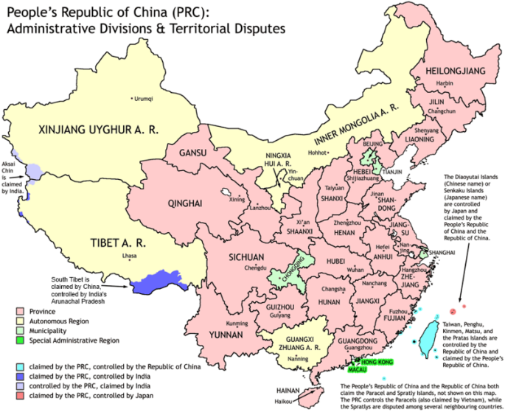
2.1 General Market Information
Geography: 9,6 mln sq.km. territory, borders 14 countries
Population – 1.37 Bn. Urban/Rural population – 55%/45%
Official languages – Mandarin, Cantonese
Average monthly income – 4,7K RMB ($730) for employed part of the population
GDP Per Capita (Nominal) – 56,7K RMB ($8,8K)
Employment: 58,3% of the population, including 29,5% in agriculture, 30% in industry, 40,6% in services sector
Internet penetration* – 52.2%
Mobile penetration – 92%
Smartphone penetration – 58%
Bank account penetration – 79%
Online banking penetration – 65.7%
Bank Card penetration – 79%
Credit card penetration (2015) – 38%
Because of high internet, smartphone and bank account penetration, Chinese market is perfectly fit for the “pure online” business model
Data sources: Accenture, Deloite, CIA World Facebook, World Bank, Inquirer.net, InternetWorldStats.com, “On Device Research”, McKinsey, & iMoney, Euro Monitor Consumer Loan Lending, http://www.stats.gov.cn(2014)
* Hereinafter 2016 data
Notes:
Существуют базовые предпосылки для интенсивного роста проникновения финансовых услуг и увеличения интенсивности пользования ими(в том числе кредитования, кредитных карт и он-лайн сервисов):
1. Экономика Филиппин интенсивно развивается (рост GDP на 7.18% в 2013).
2. В ближайшие годы ожидается значительний рост трудоспособного населения (в бакете от 0-14 лет 33.7% населения;15-24 :19% населения.)
3. Ожидается увеличение темпов роста розничного-кредитного портфеля Филипин на 2 % с 14.4(за 2010-2015 года) до 16.4 (прогноз на 2015 – 2018 года)
4. Низкая база проникновения как офф-лайн финансовых услуг (26.6% проникновение счетов среди трудоспособного населения и 3% кредитных карт) , так и он-лайн (13% проникновение интернет – банкинга)
5. Активный рост проникновения смаротфонов и доступа в интернет - ожидаемый рост за год более чем на X% c текущего уровня x и на X% c текущего уровня x соответсвенно.
** Городские-не городские и города.

Slide 6
2.2 Market Size Estimation
CAGR=9%
Unsecured consumer finance market size is estimated to reach $1,6 Tn by 2020
PDL share of the market is estimated at 0,5-1% of the total market
Current sales assumptions lead to 0,25-0,5% market share by 2020
 | Year 1 | Year 2 | Year 3 | Year 4 | Year 5
Net credit portfolio, $M | 3,2 | 9,3 | 16,5 | 21,8 | 22,1
#loans sold, K | 71 | 371 | 714 | 1,096 | 1,195
* http://www.chinatimes.cc/article/51502.html; http://think.sifl.org/?p=6998, Euromonitor, The Boston Consulting Group

Slide 7
3.1 “Standard” licensing options
# | Parameter | Bank | Consumer Finance Company (CFC) | Micro Lending Company (MLC)
1 | Purpose | Full-range banking activity for retail and corporate banking | Personal lending activity | Personal lending and SME activity
2 | Regulator | China Banking Regulatory Commission (CBRC) | China Banking Regulatory Commission (CBRC) | Financial offices in provinces
3 | Official min paid capital requirements | $150M | $46M | $15-30M
4 | Max foreign capital share | 100% | 100% | No restrictions for foreign capital, but several local shareholders may be required (depends on specific province)
5 | Possibility to sell retail credit products | Yes, all products | Yes, except credit cards | Yes, except credit cards
6 | Possibility to collect retail deposits | Yes | No | No
7 | Number of active licenses | 832 (EOY‘14) | 15 (EOY‘16) | 8 965 (EOY‘15)
8 | Recommendation | Not recommended due to large minimal capital requirement and difficulty in obtaining the license | Not recommended due to difficulty in obtaining the license at present time (this type of license type was introduced into the market relatively recently) | Possible option to consider, but due to long processing time and capital requirements can be considered to be used at a later stage in the project
Neither of the “standard” licensing options can be recommended for entering China, so for quick start we need to consider non-standard options. The MLC option can be considered for use when the business case in China is proven, further business growth is required and high license cost is justified

Slide 8
3.2 Other licensing options
# | Parameter | Insurance company | P2P | Lending using “Trust Company” | Pawnshop
1 | Purpose | Insurance business, consumer lending via LGFV* | Bringing together private investors & borrowers | Consumer finance using sponsor’s licence | Collateralized cash lending activity
2 | Regulator | China Insurance Regulatory Commission (CIRC) | Not Regulated (Financial offices in provinces according to the draft of p2p regulation) | China Banking Regulatory Commission (CBRC) | Commerce departments and public security bureaus in provinces
3 | Minimum paid-in capital | $31,5M | Not regulated ($4,5M within 5 yrs. according to the draft of the regulation) | $150K – minimal investment amount, some minimal charter capital of the company may be required | $0,5M
4 | Max foreign capital share | 100% non-life, 50% life | 100% in WFOE and indirect control of the local entity | 100% in WFOE and indirect control of the local entity | No regulations for foreign owned pawnshops implies that PS can not be foreign-owned
5 | Possibility to sell retail credit products | Yes (via LGFV) | Yes, except credit cards | Yes, except credit cards | Yes, only loans with collateral
6 | Possibility to collect retail deposits | No | Collecting investment from individual investors is not prohibited, but has some unformal restrictions for new platforms | No | No
7 | # Active licenses | 116 (2014) | 2570+ (2015) | >30** (2015) | ~500-5000
8 | Recommendation | Not recommended because requires partnership with local government and relatively high capital requirements | Feasible, with serious limitations on advertising, single investor scheme requires HNWI local investor | Feasible, but requires passing Trust company compliance | Not feasible due to strict interest cap regulation, and our inability to keep pledged asset with the borrower
* Local Government Financial Vehicle ** Currently we’ve identified 2 companies providing “licensing sponsorship” – “FOTIC” (30 clients) and CITIC (1 client). Both companies are founded by Chinese banks.

Slide 9
3.3 Licensing strategy
Phase 1 (up to ~6 months)
P2P: single investor
Phase 2 (up to 1-2 years)
Lending via trust company
Start with p2p with single/several (nominee) investors. Loan disbursement will be done from the investor’s bank account
Main purpose – create local team and test business processes (especially decision making process, customer experience, collection procedures, pilot marketing campaigns, etc.)
There are several serious limitation imposed by this scheme onto marketing and repayment partners
However, p2p could still be a viable option in the case we run into problems with establishing cooperation with the Trust company
Cooperation with a Trust company is an official way to issue loans, essentially, this is credit institution license outsourcing
Working with a Trust will allow us to gain access to leading Chinese Internet resources (Baidu, WeChat, etc.), cooperation with whom is necessary to run large-scale advertising campaigns
We propose to start with p2p option and in parallel work on partnering with a local Trust company
At a later stage, when the business case is proven, we may consider getting an MLC license

Slide 10
3.4 Trust setup
Definition of the Trust company in China – company, holding a special permission, allowing granting loans both to individuals and legal entities and “leasing the license” (via trust asset management agreement), which is a unique feature of the Chinese financial market
In our case “LGC” (our company) will acquire potential customer, will conduct credit decisioning and send successful applicants to Trust for issuing the loan. In order to obtain a loan, the customer will need to conclude a 3-party agreement with Trust and LGC.
Contractual relations scheme:
Advantages: ability to officially issue loans on Trust balance (secured by our deposit placed at Trust), official access to credit bureaus, receiving support in negotiations with authorities, networking, etc. Also at a later stage – possibility of fundraising from the Trust company
Risks: absolute dependence on the chosen Trust partner in terms of licensing and product development possibilities, relatively expensive fees for Trust services (1% of turnover)
10
Notes:
10

Slide 11
3.5 P2P setup
Our company will provide customer acquisition services to (nominee) investors and borrowers and will charge service fee from borrowers for that. Loan disbursement will be done from (nominee) investor’s personal account to customer’s account. The other existing p2p companies, for example such as “CashBus”, “Shoujidai” also use the same scheme
Contractual relations:
Advantages: no need to obtain license, easy to start operations
Risks: nominee investor related risks, critical after reaching considerable sales volume, strict control from the authorities due to recent crash of several large local p2p companies, advertising restrictions (all the major internet resources require presenting credit institution licence as an obligatory condition)

Slide 12
3.6 Key regulatory points
# | Issue | P2P | Trust
1 | Disbursement & Repayment | Interbank transfer only. | Processed by the Trust company in cooperation with local Payment system, direct debit service is available
2 | Interest cap | 24% per annum, covers only interest rate
3 | KYC | No need in case of using customers’ existing bank accounts
4 | Big Data access | Telco data, e-commerce data (“JD”, “Taobao”), antifraud statistic | Credit bureau, Telco data, e-commerce data (“JD”, “Taobao”), antifraud statistic
5 | Remote contract signing | Available. Digital signature is allowed by law, there is a market practice of using numeric codes distributed via SMS as a digital signature, no need to obtain any official certification for digital signature
6 | Direct debit | Available. Direct debit is allowed in China and could be used for the purpose of repayment. Certified digital signature provider is needed to get access to direct debit service
7 | Other specific regulations | Foreign investment limitations (see next slides) Internet content provided (ICP) license is needed to any company which engaged in internet information service activities in China (see next slides)
Pure online business model is feasible in China

Slide 13
3.7 Foreign investment limitations
Types of legal entities available in the market:
WFOE (Wholly Foreign Owned Enterprise) – legal entity in China with foreign shareholders
LLC (Limited Liability Company) – legal entity in China with local shareholders
Basic limitations for the foreign capital investments:
It is prohibited for WFOE to use its registered capital to purchase securities (e.g. Trust products) (unless WFOE has explicit permission in its scope of operations in its license). Every time WFOE converts USD to RMB, bank requests a set of documents stating intended purpose of usage for the converted amount. Only profit from operations in China could be transferred to Trust without special permissions
Same limitations are in place for loans. We investigated guarantee-loan schemes, but all banks found this schemes not doable because of Forex control.
This mean that it is practically impossible to use WFOE to fund portfolio in China, the only solution is to use LLC for portfolio funding, because of lack of similar limitations for locally-owned entities
Cross-border capital transfer limitations:
It is prohibited to transfer money in RMB from overseas to personal bank accounts
Annual limit for foreign currency exchange is equivalent of $50K for both PRC citizens and foreigners
Because of foreign investment limitations, we won’t be able to transfer money to the Trust company for the purpose of portfolio funding from WFOE, but only from the locally-owned entity

Slide 14
3.8 Portfolio funding setup
# | Possible Solution | Comments
1 | Get amount in RMB from PRC individual, give him equivalent amount in USD in offshore | Difficult to find such a local person
2 | Use services of special money transfer companies (essentially performing similar activities to p.1 but on a larger scale) | Common market practice for China
3 | Capital injection in USD to WFOE and transfer of the injected capital to LLC via service agreement between LLC and WFOE | Expensive as 25-31% taxes will arise, so this can be considered after LLC builds up its cost base
4 | Funds transfer in RMB/USD to local person bank account in China | Difficult to process large amount as annual limit for this kind of operations is $50K for a given individual
5 | Get loan in China which is secured by guarantee deposit/securities in offshore | Unformal relationship with bank is necessary. “Home credit” used this scheme previously but was prosecuted for the reason of violating forex rules
We suggest to use option #2 at the very beginning and switch to option #3 later (when LLC builds up cost base to reduce income tax).

Slide 15
3.9 Variable interest entities (VIE)
VIE is a common solution used in China for foreign investment in restricted areas. Large international companies like “Amazon”, “Evernote”, “Alibaba” use this setup
We use VIE structure to circumvent 2 restrictions: operating in the Internet space and control of investment for foreign companies
In the VIE approach, functions will be distributed between 2 companies in the following way:
 | LLC (local company) | WFOE (foreign company)
1 | License holder (ICP license), web-site, trademark and domain owner | Marketing, decision making, CRM and other IT solutions holder
2 | Officials representative | Employer for Chinese staff
3 | Actual lender in the trust scheme, portfolio holder in the trust scheme, service provider for the trust company | Marketing, decision making, customer support, collection, etc. services to LLC
4 | Our legal representative to borrowers and investors in the p2p scheme | Marketing, decision making, customer support, collection, etc. services to LLC
5 | Taking interest rate and commissions from borrowers/investors/trust company | Extracting all extra income from LLC via service and consulting agreements and repatriating it abroad

Slide 16
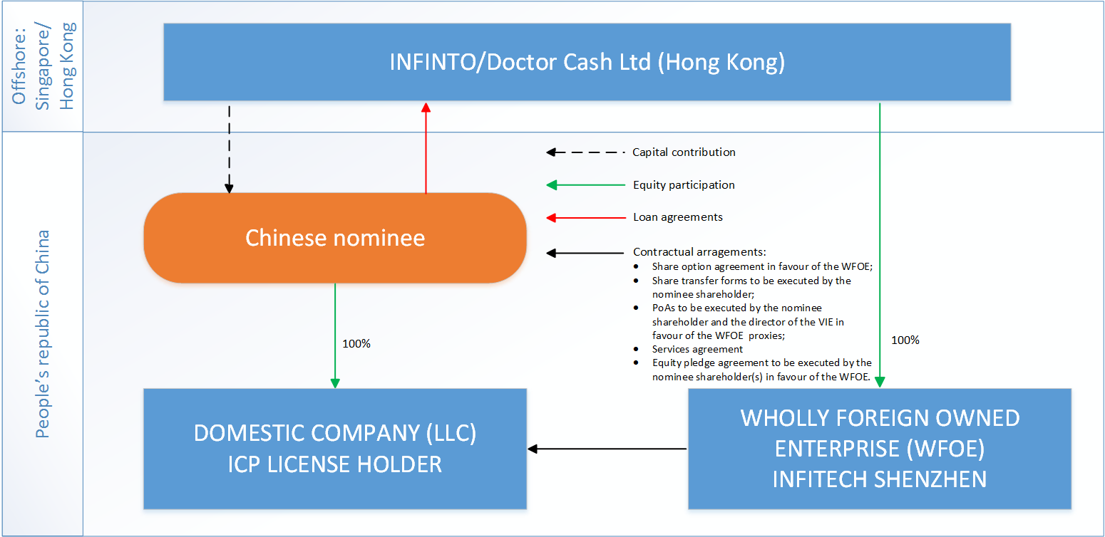
3.10 Legal setup
Fund transfers: for funding operational expenses - to registered capital of WFOE from “XXXXXXXX”, to PRC individual bank account from support SG companies, then to LLC’s registered account

Slide 17
4.1 Product parameters for competing P2P platforms
# | Parameter | “CashBus” | “Shoujidai” | “Huala Huala” | “Ppdai”
1 | Product type | PDL | PDL | PDL (and IL) | IL 3-24 months
2 | Loan amount | 500-1K RMB ($77-158) | 300-700, 1K-5K RMB ($46-108, 155-774) | 1000-10K RMB ($155-1550) | 100-100K RMB ($15-15 200)
3 | Loan tenor | 7, 14 days | 7-15 days, 7-30 days | 21, 28 days (3 months for IL) | IL 3-24 months
4 | Interest rate | 0,029% per day (10,5% per annum) | 0,03% per day (10,95% per annum) | 0,03% per day (10,95% per annum) | Defined individually
5 | Fees | Application fee 18-500 RMB ($3-77) | Bank acc verification, ID verification, etc.fees – in total 0,3%-0,03% per day | Defined individually | Defined individually
 |  | Account management fee 6-500 RMB ($1-77)
6 | Effective interest rate | 0,7% per day | 0,3-1% per day | 0,4% per day | 0,11-0,22% per day
7 | Overdue interest rate, % per day | 1% per day for first 7 days 2% per day from day 8 | 0,5% per day till DPD15, 0,75% per day after | 0,5% per day till DPD15, 1% per day after | Not specified
8 | Late payment fee (one-time) |  | 10 RMB ($1,5) | 10 RMB ($1,5) | Not specified
9 | Prolongation fee | 20 RMB ($3,1) | - | - | -
Companies mentioned here are major China PDL players, almost all other “traditional” p2p platforms offer installment loans only

Slide 18
4.2 Client requirements for competing P2P platforms
# | Parameter | “CashBus” | “Shoujidai” | “Huala Huala” | “Ppdai”
1 | Basic borrower’s requirement | Providing access to cellphone and ”Alipay” statistics | Self-supplied employment information, ID scan upload, access to Alipay statistics, CUP bank card statistics | Providing allowance to cellphone stats; Working information; ID verification; CUP bank card statistics | ID card pictures, ID verification, Working information, cellphone statistic
2 | Credit contract signing | Remote | Remote | Remote | Remote
3 | Marketed Time-to-money (TTM) | 30 min.* | - | n/a | 1 hour*
4 | Actual TTM | 3 days* | 3 days* | n/a | 3 days*
Pure online business model is already used in China by PDL businesses
Even though some competitors market “1 hour” TTM, actual TTM time is about 3 days. That means that the “true” emergency cash providers are not there yet and we will occupy that niche
* Results of the mystery shopping survey conducted.

Slide 19

4.3 Competitor case study: “Cash Bus”
HQ based in Shanghai, operates nation-wide
Launched sales in Dec’14, as of mid-’15 have disbursed ~50K loans
Before Aug’15 processed 2K apps and disbursed 200 loans daily
In Feb’16 increased operational staff 3-5x
Product: 500-1K RMB ($79-157) cash loan for 7-14 days
EIR – 0.71% per day
Advertising – mostly through “WeChat” (local analogue of FB & mobile messenger) blog
Business process description:
Applicant adds company’s account as a friend in “WeChat”
Applicant fills in loan app form (providing consent to access cellphone/”Alipay” statistics)
Applicant passes phone verification
From approval to loan disbursement – 1 hour (stated), 1 hour (mystery shopping)
Money transfer speed – online (on working days)
Main achievements:
Opened new market segment accepting PDL with EIR>0,7% per day
Granted 50K loans during first 9 months
Developed internal application in “WeChat”, mobile application, social-lifestyle scoring using cellphone and “Alipay” (large local payment system) statistics
In the summer of 2015 “CashBus” processed over 2K apps daily, claiming almost zero marketing expense. AR was reported at 5%, losses estimated at ~10% (DPD60+), even though they do not have access to credit bureaus
19

Slide 20

4.4 Competitor case study: “Shoujidai”
HQ based in Shanghai, operates nation-wide
Launched sales in Oct’13
Product: 300-5K RMB ($46-774) for 7-30 days
EIR at 0,3% per day
Advertising – online marketing, client referrals
Business process description:
Applicant downloads mobile app
Applicant registers her phone number
Applicant fills in loan app form
Decisioning includes obligatory authorization for big data access, phone verification
Money transfer speed – online (on working days)
Main achievements:
Pioneer in the Mobile Internet P2P area
The first lending company in China with “mobile app” business model
Integrated to large number of Big Data suppliers
Repeat loan can be granted within 2 min after application
Raised $10M A-round in Mar’15. This, together with their non-aggressive pricing policy raises concern on their true focus: aggressive growth at the expense of profitability
20

Slide 21

4.5 Competitor case study: “Huala Huala”
HQ based in Chengdu, Sichuan, issues loans in cooperating with trust company (“FOTIC”)
Launched sales in Oct’13
300K registered users
Product: 1K-5K RMB ($155-774) cash loan for 21-28 days
EIR at 0,4% per day
Advertising: “WeChat”, “Weibo”
Business process description:
Applicant downloads Mobile app
Applicant registers his phone number
Applicant fills-in loan app form, including taking selfie with ID
Decisioning includes pulling data from “JD”, “Taobao”, telco operator
Money transfer speed – online (on working days)
Main achievements:
Ranks No. 1 in Microloan Mobile App
21

Slide 22

4.6 Competitor case study: “Ppdai”
HQ based in Shanghai
Launched sales in 2007
Business model unusual for China – “classic p2p”, when investors carry risks
Product – installment loan with amount from 100 to 100 000 RMB ($15-15,000), term 3 to 24 months
The EIR is calculated separately for each borrower depending on his credit score (40-80% annually)
Amount and term are also adjusted by the platform
Advertising – online marketing, client referrals
Application process: - customer downloads mobile app - registers with the phone number - fills in application form - gives big data access authorization - accepts approved loan parameters - gets loan after platform identifies investors
Business process description:
From applying to obtaining credit decision – 60 min
From approval to loan disbursement – 3 working days
Money transfer speed – online (on a work week, not working nights and weekends)
Main achievements:
First and the most famous pure p2p platform, not bearing any credit risk
Ppdai case proves that the Chinese trust online p2p platforms and are ready to invest with them (because of 3-5x higher interest rate compared to the traditional bank deposits)
22

Slide 23
4.7 Our Product Parameters
# | Parameter | Value
1 | Product type | PDL
2 | Loan amount | 500-2K RMB ($77-310)
3 | Loan tenor | 7, 15, 21, 30 days
4 | Interest rate | 0,05% per day (18,25% per annum)
5 | Service fee (charged as a one-time fee for the whole LT) | 0,95% per day
6 | Effective interest rate | 1% per day
7 | Overdue interest rate | 1.5%
8 | Late payment fee (one-time fee) | 100 RMB ($15)
9 | Prolongation fee | 0%
10 | Special features | LPF Grace period (GP) – 3 calendar days
We will launch in China with our standard PDL product

Slide 24


4.8 First sale business process
ID recogniser
Black lists
Cellphone, AliPay, Taobao, JD, College, Travel tickets statistic provider
WeChat
MinShi
Tongdun/91credit
Quantgroup
GL: Kingdee
Applying
Decisioning
Contract signing
Loan granting
Terasoft
1.Filling with partners
5.Visual stop factors check
14. Money transfer to existing bank account/CUP card
2.Filling via WeChat APP
6. Stop factors check
9. Credit bureau request (trust only)
10. Credit rules application
11. Phone verification (3)
Loan confirmation
12. Digital contract signing
13.Loan granting
Union Pay
7.ID falsify check
8. Big Data request
Customer
3. Filing via mobile APP
14. Sending contract PDF copy to customer
Functionality already available in Terrasoft and planned to be used
4.Filling online app on website
New functionality to be implemented in Terrasoft
functionality already integration with WEB
SMSs
luosimao.com
Fotic Trust Company
Credit bureau provider
New integrations to be implemented in WEB and Terrasoft
Target business process will allow us to reach Time-to-money (TTM) of 30 “working” min., which is a unique offer for China

Slide 25
5.1 China digital market overview
# | Parameter | P2P | Trust
1 | Advertising restrictions related to legal setup | Advertising on all major Internet marketing platforms (“Baidu”, ”Tencent”, etc.) is hindered by the fact that the majors require credit institution license (common practice of the captive p2p’s); SEO possibilities are limited | No restrictions
2 | Marketing landscape | China is the biggest online market in terms of number of Internet and mobile users. Most popular local social network (“WeChat”) has over 500M daily active users China has local analogues for all most popular global services (“WeChat” for “FB”, “Baidu” for “Google”, etc.) Major international internet marketing platforms are unavailable in China because of the “Great Chinese firewall” Offline advertisement is very expensive for small and medium companies and is usually not used by the competitors
3 | Available tools | Content marketing strategy (paid promotion posts and advertorials) CPC advertisement on small platforms (Momo) | “Wechat”, “Baidu”, “QQ”, “SoGou”, “360”, etc (all big internet platforms)
China online market is very well developed in the terms of penetration of mobile and online services and different advertising formats. Despite the absence of global players like “Google” or “FB”, our digital sales experience in other markets can be replicated in China, since there are local substitutes
Our marketing strategy will vary depending on the legal setup being used at the moment

Slide 26












5.2 China digital marketing majors
Local analogue | International | Comments
 |  | “WeChat” is the most popular Chinese social network with over 650M daily active users (over 500M in China proper)
 |  | “Google” is banned is China, local substitute is “Baidu”
 |  | There are other players with relatively high user count: “QQ” (analog of ICQ, 829M accounts), “Weibo” (analog of Twitter, 220M accounts) “360Haosou” – second popular search service “Sogou” – third popular search service
China digital market players is quite similar to other markets. While global players (Google, Facebook, Twitter, Instagram, etc.) are not present because of local policy, there are local substitutes pretty much for every service
Social media marketing is one of the most important promotion tools. We will use this tool from the get-go to optimize cost of acquisition in the long run
In order to cooperate with large local resources we need to obtain (or “rent”) credit institution license
Notes:
При низком показателе проникновения кредитных продуктов, основная их часть сосредоточена в сегменте SEC A и SEC B, при высоких требованиях к заемщику. Стратегия DCFC – всегда доступная финансовая поддержка рядом с клиентом посзволяет ориентироваться на 70% рынка.

Slide 27
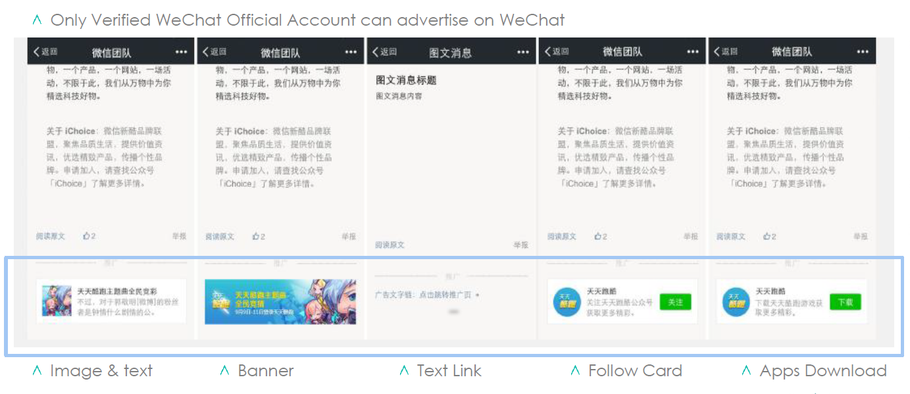
5.3 Marketing platforms overview: “WeChat”
WeChat is the most popular social network (over 500 mln daily active users in China). This is a social network with the following set of functions:
Chats (like WhatsApp) between users – basic functionality
Moments – analog of news line on Facebook, where users share their messages
Official account – analog of official pages on Facebook or groups in VK. WeChat adds some advertisement content to the official accounts articles, this advertisement can be purchased
Internal applications and companies official accounts – customers can date, order taxi or even apply for a loan via WeChat
Customers spend most of their time reading the Moments (like in Facebook), reading news from Official Accounts and chatting with friends
WeChat provides online advertisement service with CPC-based price policy to the corporate clients
Advertisement is placed at the bottom of Official Accounts articles (not in the news line like on Facebook)
Notes:
При низком показателе проникновения кредитных продуктов, основная их часть сосредоточена в сегменте SEC A и SEC B, при высоких требованиях к заемщику. Стратегия DCFC – всегда доступная финансовая поддержка рядом с клиентом посзволяет ориентироваться на 70% рынка.

Slide 28
5.4 “WeChat” overview: How does it work?
Video
Please watch the video now
Notes:
При низком показателе проникновения кредитных продуктов, основная их часть сосредоточена в сегменте SEC A и SEC B, при высоких требованиях к заемщику. Стратегия DCFC – всегда доступная финансовая поддержка рядом с клиентом посзволяет ориентироваться на 70% рынка.

Slide 29
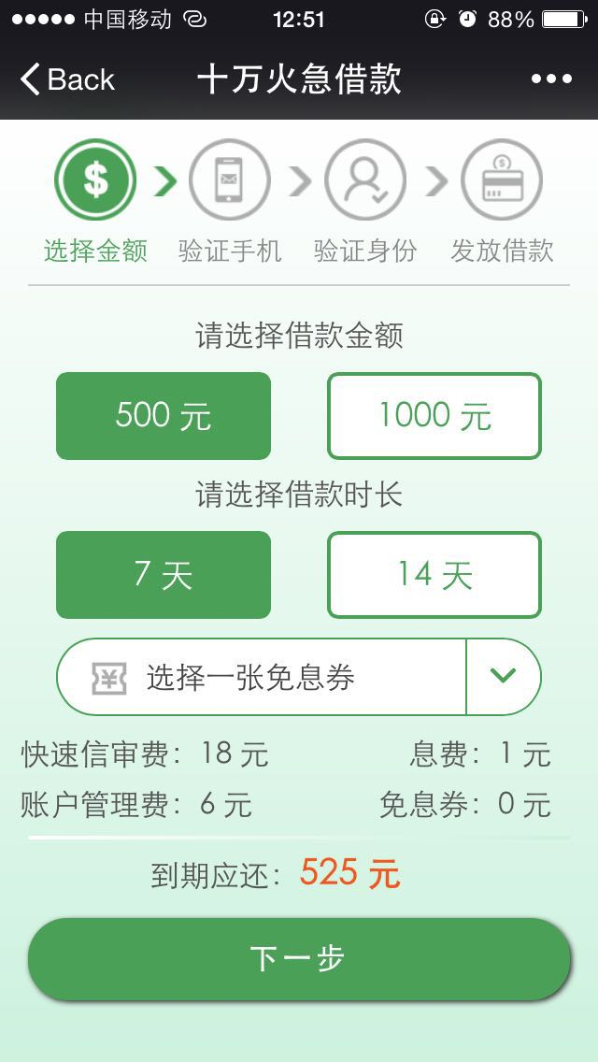
5.5 “WeChat” overview: public account
Account type and functionality | Unverified subscription account | Verified subscription account | Unverified service account | Verified service account
Messages displayed in chats with push notification (4/month) | × | × | √ | √
Messages displayed in subscription folder (1/day) | √ | √ | × | ×
Direct communication with followers | √ | √ | √ | √
Customized interactive menu | √ | √ | √ | √
Application, advertisement | × | × | × | √
It’s a common practice when companies establish official accounts in “WeChat” to promote their services or monetize customer base by providing “WeChat” permission to place advertisement (on a profit-sharing basis)
There are 4 types of official accounts. To do advertisement campaigns and receive applications from “WeChat”, we need to register a verified service account (already done)
Notes:
При низком показателе проникновения кредитных продуктов, основная их часть сосредоточена в сегменте SEC A и SEC B, при высоких требованиях к заемщику. Стратегия DCFC – всегда доступная финансовая поддержка рядом с клиентом посзволяет ориентироваться на 70% рынка.

Slide 30
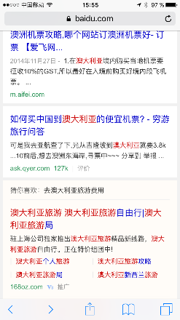
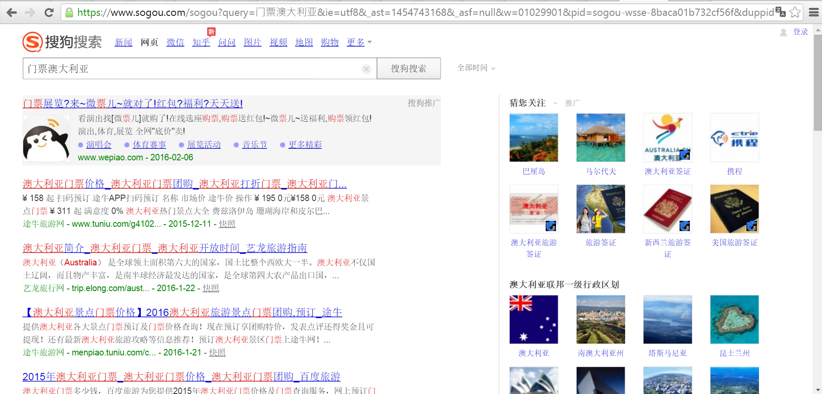
5.6 Search platforms advertisement formats
“Baidu”:
“SoGou”:
“360 Haosou”:
China search platforms have advertisement formats and price policy very close to those of Google
Notes:
При низком показателе проникновения кредитных продуктов, основная их часть сосредоточена в сегменте SEC A и SEC B, при высоких требованиях к заемщику. Стратегия DCFC – всегда доступная финансовая поддержка рядом с клиентом посзволяет ориентироваться на 70% рынка.

Slide 31
5.7 Content marketing: case study
In order to get preliminary market information, we conducted test marketing campaign with the help of a local marketing agency; campaign duration was 1 month (05.08.2016 – 05.09.2016)
Campaign start date | Type of activity | Numbers of websites | GEO | Web site example | Summary budget
5 August | Advertorials* | 22 | Nation wide | http://info.service.hc360.com | $ 3 000 (50% preparation 50% marketing)
5 August | Posts** | 13 |  | http://q.163.com/zhcaij
Campaign results
Applications received per day
Parameter | Fact | CR %
Visits (clicks) | 58 178
Short apps | 42 482 | 73%
LongApps (completed web application) | 17 117 | 40%
Successful apps (filters passed) | 11 291 | 65%
Geo filters passed | 565 | 5%
Loan disbursed | 21 | 3,7% (0,18% from successful apps)
Our test demonstrated that content marketing is one of the viable channels in China digital space, with low acquisition cost (in this test estimated to be around $6/loan if geo filters are removed (leading to 60% area coverage)
* Advertorial – advertisement giving information about a product in the style of an editorial or objective journalistic article
** Post – short promo post about our product and company (restriction 5000 letters)

Slide 32
5.8 Sales funnel projections*
Sales funnels
 | Baidu | SoGou, 360Haosou | WeChat | Content marketing
Visits (clicks) | $0.6 | $0.45 | $0.25 | $0.1**
Long app (completed web apps) | 10% | 8% | 5% | 5%
Autochecks | 90% | 90% | 90% | 60%
Cell phone check passed | 80% | 80% | 80% | 80%
Antifraud check passed | 60% | 60% | 60% | 50%
ID falsify check passed | 76% | 76% | 76% | 76%
PV passed/loan disbursed | 80% | 80% | 80% | 80%
Channel acquisition cost | $22.84 | $21.42 | $19.04 | $13.71
** CPC estimate for the content marketing is assumed to be higher than what we saw in the test environment
At the p2p stage, we are going to use content marketing (advertorials and posts). After signing agreement with the Trust company, we will add traditional digital sales channels and advertisement tools based on CPC pricing model.
We expect acquisition cost decrease from $20 per loan in 2016 to $15 in 2021 due to advancement of our digital sales expertise and increased customer awareness of our brand
* Projections are based on the information provided by the local marketing agency plus our own test (see previous slide)
Notes:
При низком показателе проникновения кредитных продуктов, основная их часть сосредоточена в сегменте SEC A и SEC B, при высоких требованиях к заемщику. Стратегия DCFC – всегда доступная финансовая поддержка рядом с клиентом посзволяет ориентироваться на 70% рынка.

Slide 33
5.9 Sales Plan
Short term sales plan
 | Month 1* | Month 2 | Month 3 | Month 4
Number of new clients per month | 50 | 100 | 300 | 600
Long term sales plan
 | Year 1 | Year 2 | Year 3 | Year 4 | Year 5
Total number of loans disbursed per year | 71K | 371K | 714K | 1,096K | 1,195K
* Currently month 1 is Sep’16

Slide 34
6.1 Risk Management Strategy
Our risk management strategy in China will be based on the following points:
Decision making process will be based on data from 3-d party antifraud system and other customer’s data (like cellphone statistic) to verify customer’s behavior and his ability to pay
Fraud detection to prevent professional fraud attacks will be based on domestic ID recognition service and cooperation with black list providers
Strong collection process: intensive and aggressive contacts with ‘bad’ borrowers and their frequent contacts, using direct debit (after start cooperation with Fotic) and cooperating with collection agencies to improve our internal processes. Expert’s opinion: our recovery rate should be around 75% (from 0+ due), but in financial model we put more conservative assumptions
We will define 2 stages of developing risk management process:
Early stage – technical volumes (1-2 months). Most manually checks, analyzing of real customer’s profile, development BRD for automatization of decision making process.
Intermediate stage (2-12 months). Step-by-step data sources implementation in our automatic decision making module. Developing and implementing score cards for decision making and collection. Improving verification and collection process.

Slide 35
6.2 Risk Management Tools Overview
Anti-fraud data providers:
P2P platforms and micro-finance companies do not have access to official credit bureau (PBOC), Tongdun is substitute which provides data about:
delinquency in p2p platforms and MFIs.
multyapplying to p2p platforms and MFIs.
information from courts, black lists in e-commence platforms.
Tongdun is the biggest Anti-fraud data provider in China, it contains over 3 000 000 records, estimated hit rate:
>98% at the beginning stage due to multyapplyting (current statistic).
55-60% at the mature stage (information from Tongdun).
Cost per request 0,16 USD (45 000 USD – annual cap fee for unlimited access).
#1 data provider for current decision making strategy.
Cell phone statistics:
This data could be downloaded automatically during application filling process, authorization process passing is mandatory.
Customer’s phone history: counterparty#, time, duration.
Customer’s SMS history: counterparty#, time.
Customer’s GPRS flow.
Cost per request – 0,4-1 USD (depends on volume).
We will use this data to verify urgent contacts number, analyze customer’s behavior and relationship with other money lending companies.

Slide 36
6.3 Risk Management Tools Overview
ID falsify check/recognition service
Any Chinese individual has ID as main document and must renew it every 5 years
There are service providers who have access to state ID database and could extract ID holder’s photo by providing his ID number, cost per request – 0,3 USD
Those providers could compare photo on ID with photo in state database and compare customer’s photo with photo in database. Such service decreases ID falsify fraud almost to zero
We will compare effectiveness of this service versus manual data checking
Step 1 – customer makes photo of his ID from APP
Step 2 – customer makes selfie with ID in the front

Slide 37
6.4 Risk Management Tools Overview
Direct Debit:
Direct Debit is allowed in China and the standard market practice for repayment, cost per success transaction is 0,3 USD
To use this service we should sign a digital agreement with customer and use special provider (market practice – asking allowance for direct debit during the application process)
This service will be used in repayment and collection process
In April 2016 direct debit providers tightened requirements for partners: if partner use digital signature for contract signing certified digital signature provider is mandatory
Credit Bureau:
There is only 1 credit bureau in China – PBOC Credit Bureau, it contains over 400 million records (~50% urbanized Chinese citizen)
Only Banks, Insurance companies, Trust companies and Consumer Lending companies have legal access to PBOC credit bureau legally (MFI and p2p platforms have only shadowy access to credit bureau with next day response and non-stable access)
PBOC credit bureau does not have data about p2p and MFI loans, but there is data about credit cards, mortgage and bank’s loans
Chinese citizen can request data from PBOC bureau by himself, authorization process takes 24 hours.
We can use access to credit bureau if we will cooperate with trust company
Therefore, we estimate quite low hit rate for PBOC credit bureau due to lack of information about p2p and MFI loans

Slide 38
6.5 Application Process (target process)
# | Stage | Procedure | Content, pilot stage, apr (fact) | Content, early stage, apr (forecast) | Content, mature stage, apr (forecast) | CPC-based traffic, apr (forecast) | $
1 | Autochecks from the Credit policy (Geo, Age, Social status, etc.) | Customer fills in his personal data, our system automatically decides to do “soft decline” because of stop factors or do requests to 3d party data supplers | 5% | 20% | 60% | 90% | 0
2 | Cell Phone statistic check | Authorization in customer’s private cabinet via his personal password and SMS, downloading and analyzing cell phone statistic | 80% | 80% | 80% | 80% | 0,68
3 | Antifraud check | Our IT system automatically does request to Toungdung (and other anti-fraud systems in future), if customer rejected by antifraud rules, system shows him “soft decline” message and stops doing requests to other 3d party systems | 10% | 25% | 50% | 60% | 0,15
4 | ID falsify check | Customer makes his ID photo, our system provides this phone to 3d party provided | 95% | 95% | 95% | 95% | 0,15
5 | ID recognition | Customer makes selfie photo with his ID in front, we compare his face and photo from ID database | 60% | 60% | 80% | 80% | 0,15
6 | Verification | Interview with customer (and urgent contacts if necessary) | 80% | 80% | 80% | 80% | 0
 | Total |  | 0.18% | 1.82% | 14.59% | 26%
Planned AR will vary from 1,8% at early stage to 14,5% at mature stage. The cost of the third party services for credit decisioning will also vary from $1,6 to $0,6 appropriately.
AR for autochecks and antifraud rules will increase due to opening our service in new provinces and brand awareness improvement. ID data autorecognition functionality will increase CR.

Slide 39
6.6 Post-Loan Collection Strategy
Collection Strategy Based on Account Age and Days (sample for 30 days loan)
Collection |  | Days after Due Date
Account Age | Tools & Actions | 1 | 2 | 3 | 4 | 5 | 6 | 7 | 8 | 9 | 10 | 11 | 12 | 13 | 14 | 15 | 16 | 17 | 18 | 19 | 20 | 21 | 22 | 23 | 24 | 25 | 26 | 27 | 28 | 29 | 30
M0 | SMS reminder
M1 | SMS reminder
 | phone calls
M | legal dunning letter
 | Site Visit (outsourced)
*Note: The risk rank is based on the score bands of collection models.
Actions
First call – at the half tenor of loan to remind about due date and prolongation option
1-3 days before due day we will remind borrower about payment (depend on weekend)
In the case of overdue contact to customer each day till dpd 30
If customer cannot afford full repayment we will propose him prolongation
We will use direct debit service to increase collection rates after establishing cooperation with the Trust company
To do site visits we will use only outsource collection agencies
*Note: The risk rank is based on the score bands of collection models.

Slide 40
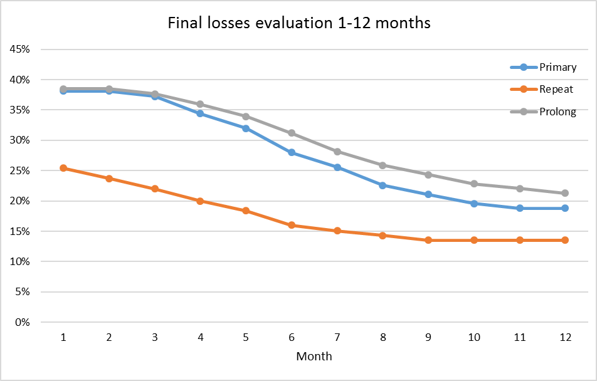
6.7 Risk Costs Forecast
Starting with manual check for
ID verification
Antifraud
Cellphone statistic
Phone verification
Decision making process automatization, data sources implementation
We expect new loans losses to be at 30~40% at the onset, gradually decreasing to 20% at EOY1 and then to 19% at EOY2, while repeats starting at 25% and stabilizing at 14% within the same timeframe

Slide 41
7.1 IT scope of work
# | New functionality | The essence
1 | ID verification | Verification ID by selfie photo of customer with his ID card before his face. (Minshi)
2 | Warehouse for Big Data | Warehouse for Big Data (Alipay, Taobao, JD, Cellphone, College, Travel, Credit Bureau, etc)
3 | Integration with Big Data suppliers | Obtaining access to customers Big Data via SMS-authorization, extracting, parsing and collecting this Big Data ([Youfen or Taiyue], [Juxinli, QuantGroup or ppdai], Fotic)
4 | Digital contract signing | Signing a digital contract with 6-digit SMS, integration with CFCA
5 | Web portal for individuals Investors&Borowers development | Web portal with online applications for both credit and deposit products, personal accounts for Borrowers and Investors with possibility to get related services (Phase 2).
6 | Online Disbursement and Repayment | Online disbursement and repayment via payment company (Yeepay)
7 | WeChat public account | WeChat internal application with front-end functionality: filing the application form, authorization for Big Data access, contract signing (WeChat)

Slide 42
7.2 IT integration partners
# | Integration partner | Type | Comments
1 | “Kingdee” | GL system supplier | First stage – integration with excel files export/import Agreement is available
2 | “Amazon” | Data center for CRM | Agreement is available
3 | “Amazon” | Call-center service provider | Agreement is available
4 | “luosimao.com” | SMS-provider | Integration via API, API description and agreement are available
5 | “KFT Pay”, “CFCA” | Repayment, Digital signature provider | Integration via API, API description and agreement are available
6 | “MinShi” | Online customer’s data validation (ID/Facial recognition + ID info verification) | Integration via API, API description and agreement are available
7 | “Tongdun” | Black lists supplier | Integration via API, API description and agreement are available
8 | “Quantgroup” | Online customer’s data validation (Cell phone, Taobao, JD.com, College Degree, Travel(Railway, Lodging & Airlines) statistic) | Integration via API, API description and agreement are available
9 | “FOTIC” Trust company | Disbursement, credit bureau access | First stage – integration via text files sending, API integration will be developed in second stage, agreement is available

Slide 43
8.1. Financial model assumptions
Product | Avg term | Avg ticket | Losses,%
New | 25 | 200 | 14.1%
Repeat | 25 | 250 | 10.6%
Prolongation new | 30 | 200 | 25.0%
Prolongation repeat | 30 | 250 | 25.0%
Product parameters | Value
Normal interest rate, per day | 1.00%
Late penalty interest rate, per day | 1.50%
Late payment fee, USD | 15
Year of project | 1 | 2 | 3 | 4 | 5
MAC, USD per loan | 20 | 20 | 18 | 16 | 15
Repeat sales per new loans | 123%
Prolongations per all loans | 79%

Slide 44
8.2. Investment summary
Investments, thsd USD | Year 1 | Year 2 | Year 3 | Year 4 | Year 5 | Total
Portfolio investments | 4 114 | 7 160 | 3 941 | 36 | 0 | 15 252
OPEX and CAPEX investments | 3 075 | 3 422 | 0 | 0 | 0 | 6 497
Total investments | 7 190 | 10 582 | 3 941 | 36 | 0 | 21 749
Volume indicators | Year 1 | Year 2 | Year 3 | Year 4 | Year 5 | Total
Number of loans issued, thsd | 71 | 371 | 714 | 1 096 | 1 195 | 3 447
Amount disbursed, thsd USD | 11 613 | 53 022 | 97 001 | 145 070 | 152 229 | 458 935
Net portfolio (EoY), thsd USD | 3 246 | 9 304 | 16 507 | 21 824 | 22 148 | 22 148
P&L, thsd USD | Year 1 | Year 2 | Year 3 | Year 4 | Year 5 | Total
Revenue | 2 905 | 18 603 | 37 831 | 60 346 | 67 452 | 187 137
Provisions | -2 630 | -11 254 | -18 742 | -25 387 | -27 293 | -85 307
Variable costs | -1 838 | -7 762 | -11 640 | -16 304 | -17 175 | -54 719
Marketing acquisition costs | -641 | -2 354 | -3 627 | -4 658 | -4 526 | -15 806
Salary (variable part) | -604 | -2 568 | -3 717 | -5 090 | -5 523 | -17 502
Other variable costs | -426 | -1 774 | -2 128 | -3 099 | -3 260 | -10 687
VAT | -166 | -1 066 | -2 168 | -3 458 | -3 865 | -10 724
Fixed costs | -1 607 | -3 203 | -3 202 | -3 307 | -3 268 | -14 586
Salary (fixed part) | -895 | -2 036 | -2 036 | -2 036 | -2 036 | -9 039
Other G&A expenses | -712 | -1 167 | -1 166 | -1 271 | -1 232 | -5 548
One-off expenses | -211 | 0 | 0 | 0 | 0 | -211
Net profit before taxes | -3 381 | -3 616 | 4 247 | 15 348 | 19 717 | 32 314
Terminal value |  |  |  |  |  | 96 103
ROE (annualized) |  |  |  |  |  | 59%
ROAA (yearly) | -208% | -58% | 33% | 63% | 67% | 29%
Break-even period – 24 months
Self-capitalization period – 35 months
Payback period – 61 months
Total investments from – $21,7M
Unoptimized Yr5 corporate tax – $4,9 M

Slide 45
8.3. Balance sheet
Balance Sheet (EOY)
thsd USD | Year 1 | Year 2 | Year 3 | Year 4 | Year 5
Assets | 3 809 | 10 775 | 18 962 | 25 173 | 25 545
Liquid assets | 487 | 1 396 | 2 380 | 3 274 | 3 322
Loans to individuals (net of provisions) | 3 246 | 9 304 | 16 507 | 21 824 | 22 148
Total loans | 5 877 | 23 188 | 49 134 | 79 837 | 107 454
Risk provisions - PDL | -2 630 | -13 884 | -32 626 | -58 013 | -85 307
Other assets | 75 | 75 | 75 | 75 | 75
Shareholders' equity | 3 809 | 10 775 | 18 962 | 25 173 | 25 545
Contributed equity | 7 190 | 17 772 | 21 713 | 21 749 | 21 749
Retained earnings | -3 381 | -6 997 | -2 751 | 9 245 | 24 032
Dividens paid | 0 | 0 | 0 | -5 820 | -20 236
Equity+Liabilities | 3 809 | 10 775 | 18 962 | 25 173 | 25 545

Slide 46
8.4. P&L Statement
P&L
thsd USD | Year 1 | Year 2 | Year 3 | Year 4 | Year 5 | Total
Interest Income | 2 905 | 18 603 | 37 831 | 60 346 | 67 452 | 187 137
Primary sales | 1 634 | 8 435 | 16 175 | 24 915 | 26 715 | 77 874
Repeat Sales | 1 271 | 10 168 | 21 656 | 35 431 | 40 738 | 109 263
Risk provisions | -2 630 | -11 254 | -18 742 | -25 387 | -27 293 | -85 307
Primary sales | -1 710 | -5 741 | -9 007 | -11 626 | -12 057 | -40 140
Repeat Sales | -921 | -5 513 | -9 735 | -13 760 | -15 237 | -45 166
Variable costs* | -1 838 | -7 762 | -11 640 | -16 304 | -17 175 | -54 719
Marketing acquisition costs | -641 | -2 354 | -3 627 | -4 658 | -4 526 | -15 806
Salary (variable part) | -604 | -2 568 | -3 717 | -5 090 | -5 523 | -17 502
Other variable costs | -426 | -1 774 | -2 128 | -3 099 | -3 260 | -10 687
VAT | -166 | -1 066 | -2 168 | -3 458 | -3 865 | -10 724
Operating profit (before fixed costs) | -1 397 | 653 | 9 617 | 22 113 | 26 850 | 57 835
Fixed costs* | -1 607 | -3 203 | -3 202 | -3 307 | -3 268 | -14 586
Salary (fixed part) | -895 | -2 036 | -2 036 | -2 036 | -2 036 | -9 039
Other G&A expenses | -712 | -1 167 | -1 166 | -1 271 | -1 232 | -5 548
One-off expenses | -211 | 0 | 0 | 0 | 0 | -211
Profit before Taxes** | -3 381 | -3 616 | 4 247 | 15 348 | 19 717 | 32 314
* See slide 8.7 and 8.8 for details
** Estimated amount of profit tax for 5th year is $4.9 mln.

Slide 47
8.5. Cash flow Statement
Cash flow
thsd. USD | Year 1 | Year 2 | Year 3 | Year 4 | Year 5 | Total
Loans issued | -11 613 | -53 022 | -97 001 | -145 070 | -152 229 | -458 935
Principals received | 5 736 | 35 711 | 71 056 | 114 366 | 124 612 | 351 481
Interest received | 2 905 | 18 603 | 37 831 | 60 346 | 67 452 | 187 137
Loan fees received | 0 | 0 | 0 | 0 | 0 | 0
Fines & penalties received | 0 | 0 | 0 | 0 | 0 | 0
Total CF from business activities: | -2 972 | 1 291 | 11 886 | 29 642 | 39 835 | 79 683
Commissions to agents & payment systems | -148 | -686 | -1 261 | -1 894 | -1 991 | -5 979
POS costs | -75 | 0 | 0 | 0 | 0 | -75
People costs | -1 499 | -4 604 | -5 753 | -7 126 | -7 559 | -26 540
Marketing & Acquisition costs | -649 | -2 354 | -3 627 | -4 658 | -4 526 | -15 814
Support costs | -249 | -883 | -478 | -638 | -637 | -2 886
Office costs | -417 | -1 060 | -1 266 | -1 548 | -1 575 | -5 866
IT costs | -384 | -202 | -179 | -179 | -179 | -1 122
Professional services | -99 | -74 | -74 | -74 | -74 | -397
Other income (expenses) | -43 | -36 | -36 | -36 | -36 | -187
Profit tax | 0 | 0 | 0 | -3 353 | -4 929 | -8 282
VAT paid | -166 | -1 066 | -2 168 | -3 458 | -3 865 | -10 724
Working Capital required | 0 | 0 | 0 | 0 | 0 | 0
Total CF from operating expenses: | -3 731 | -10 965 | -14 842 | -22 964 | -25 371 | -77 874
Total CF from operating activities: | -6 703 | -9 673 | -2 957 | 6 678 | 14 464 | 1 809
Financing received | 7 190 | 10 582 | 3 941 | 36 | 0 | 21 749
Financing returned | 0 | 0 | 0 | -5 820 | -14 415 | -20 236
Interest expense | 0 | 0 | 0 | 0 | 0 | 0
Total CF from financing activities: | 7 190 | 10 582 | 3 941 | -5 784 | -14 415 | 1 513
CAPEX | 0 | 0 | 0 | 0 | 0 | 0
Total CF for the period: | 487 | 909 | 984 | 894 | 49 | 3 322
Cash balance beginning: | 0 | 487 | 1 396 | 2 380 | 3 274 | 3 274
Cash balance ending: | 487 | 1 396 | 2 380 | 3 274 | 3 322 | 3 322

Slide 48
8.6 Headcount and Personnel budget
Group/Position | Gross costs of employment, USD | Headcount |  |  |  |  |  | Monthly cost of employment, USD
 |  | At present | EOY 1 | EOY 2 | EOY 3 | EOY 4 | EOY 5 | At present | EOY 1 | EOY 2 | EOY 3 | EOY 4 | EOY 5
Total staff (fixed+variable) |  | 10 | 102 | 254 | 377 | 442 | 448 | 51 943 | 212 652 | 451 463 | 540 913 | 610 457 | 617 524
Total fixed staff |  | 7 | 16 | 26 | 26 | 26 | 26 | 48 312 | 100 160 | 156 605 | 156 605 | 156 605 | 156 605
Mangement and direct reports |  | 2 | 4 | 6 | 6 | 6 | 6 | 13 393 | 18 772 | 37 982 | 37 982 | 37 982 | 37 982
Operations department |  | 0 | 1 | 1 | 1 | 1 | 1 | 0 | 13 687 | 13 687 | 13 687 | 13 687 | 13 687
Risk department |  | 1 | 2 | 5 | 5 | 5 | 5 | 8 187 | 21 873 | 36 730 | 36 730 | 36 730 | 36 730
Financial department |  | 1 | 4 | 5 | 5 | 5 | 5 | 13 687 | 22 996 | 26 519 | 26 519 | 26 519 | 26 519
Digital marketing department |  | 1 | 2 | 3 | 3 | 3 | 3 | 3 000 | 9 393 | 12 786 | 12 786 | 12 786 | 12 786
IT department |  | 1 | 1 | 1 | 1 | 1 | 1 | 4 523 | 4 523 | 4 523 | 4 523 | 4 523 | 4 523
Legal department |  | 0 | 1 | 2 | 2 | 2 | 2 | 0 | 3 393 | 15 079 | 15 079 | 15 079 | 15 079
HR department |  | 1 | 1 | 3 | 3 | 3 | 3 | 5 523 | 5 523 | 9 300 | 9 300 | 9 300 | 9 300
Total variable staff |  | 3 | 86 | 228 | 351 | 416 | 422 | 3 631 | 112 492 | 294 858 | 384 307 | 453 852 | 460 918
Operations department |  | 2 | 39 | 96 | 133 | 132 | 134 | 2 420 | 52 457 | 125 646 | 147 542 | 145 619 | 148 570
Verificator Teamleader | 2 262 |  | 1 | 3 | 3 | 2 | 2 | 0 | 2 262 | 6 787 | 5 769 | 3 846 | 3 846
Verificator | 1 210 | 1 | 14 | 31 | 39 | 30 | 30 | 1 210 | 16 942 | 37 515 | 40 117 | 30 859 | 30 859
Telesale operators Supervisor | 2 262 |  | 1 | 1 | 1 | 1 | 1 | 0 | 2 262 | 2 262 | 1 923 | 1 923 | 1 923
Telesale operators Teamleader | 2 262 |  | 1 | 2 | 3 | 3 | 3 | 0 | 2 262 | 4 525 | 5 769 | 5 769 | 5 769
Telesale operators | 1 210 |  | 10 | 28 | 36 | 31 | 31 | 0 | 12 102 | 33 885 | 37 031 | 31 888 | 31 888
Customer support Supervisor | 2 262 |  | 1 | 1 | 1 | 1 | 1 | 0 | 2 262 | 2 262 | 1 923 | 1 923 | 1 923
Customer support Teamleader | 2 262 |  | 1 | 2 | 4 | 4 | 5 | 0 | 2 262 | 4 525 | 7 692 | 7 692 | 9 615
Customer support | 1 210 | 1 | 10 | 28 | 46 | 60 | 61 | 1 210 | 12 102 | 33 885 | 47 318 | 61 719 | 62 747
Risk department |  | 1 | 47 | 132 | 218 | 284 | 288 | 1 210 | 60 035 | 169 212 | 236 765 | 308 233 | 312 348
Telecollector Teamleader | 2 262 |  | 3 | 9 | 14 | 18 | 18 | 0 | 6 787 | 20 361 | 26 922 | 34 614 | 34 614
Telecollector | 1 210 | 1 | 44 | 123 | 204 | 266 | 270 | 1 210 | 53 247 | 148 851 | 209 843 | 273 619 | 277 734

Slide 49
8.7 Expenses detailed
Variable costs, thsd. USD
Expenses category | Year 1 | Year 2 | Year 3 | Year 4 | Year 5 | Total
Marketing acquisition costs | -641 | -2 354 | -3 627 | -4 658 | -4 526 | -15 806
Salary (variable part) | -604 | -2 568 | -3 717 | -5 090 | -5 523 | -17 502
Other variable costs | -426 | -1 774 | -2 128 | -3 099 | -3 260 | -10 687
Telecommunications - acquisition | -17 | -71 | -96 | -95 | -99 | -378
Outbound SMS - acquisition | -7 | -32 | -59 | -88 | -92 | -278
Credit decisioning | -217 | -800 | -363 | -499 | -507 | -2 387
Payment system fees | -148 | -686 | -1 261 | -1 894 | -1 991 | -5 979
Telecommunications - support | -34 | -174 | -328 | -490 | -535 | -1 561
Outbound SMS - support | -2 | -12 | -22 | -33 | -36 | -104
VAT | -166 | -1 066 | -2 168 | -3 458 | -3 865 | -10 724
Total | -1 838 | -7 762 | -11 640 | -16 304 | -17 175 | -54 719
Fixed costs, thsd. USD
Expenses category | Year 1 | Year 2 | Year 3 | Year 4 | Year 5 | Total
Salary (fixed part) | -895 | -2 036 | -2 036 | -2 036 | -2 036 | -9 039
Other G&A expenses | -712 | -1 167 | -1 166 | -1 271 | -1 232 | -5 548
Rent/office expenses | -309 | -720 | -746 | -867 | -845 | -3 487
IT expenses | -285 | -337 | -309 | -293 | -277 | -1 501
Miscellaneous | -117 | -110 | -110 | -110 | -110 | -559
Total | -1 607 | -3 203 | -3 202 | -3 307 | -3 268 | -14 586

Slide 50
8.8 One-off costs detailed
Expenses category | Total, thsd USD
Marketing expenses | -8
Marketing guide adaptation | -3
Trademark registration | -3
Marketing materials development | -2
HR expenses | -25
Recruiting | -25
IT expenses | -178
Web sites | -7
Mobile sites&app | -30
Call center implementation | -12
Collection system implementation | -19
Scoring system implementation | -30
СRM development | -80
Total | -211

Slide 51
9. Project plan
# | Activity | Planned timing | Current status
1 | Registration of legal entities | Mar 2016 | Done
2 | Renting office | May 2016 | Done
3 | Creating team | Apr 2016 | Done
4 | Website development | Jul 2016 | Done
5 | Implementing IT solution (“Terrasoft”) | Sep 2016 | UAT (development has been completed, implementation in scheduled to be finished by 30.09.2016)
6 | Concluding cooperation agreement with Trust company | Nov 2016 | In progress (LOI agreement is signed, internal report about our company profile is compiled, compliance check procedure in progress)
7 | Launch sales in cooperation with Trust company | Dec 2016 | New

Slide 52
Appendices

Slide 53
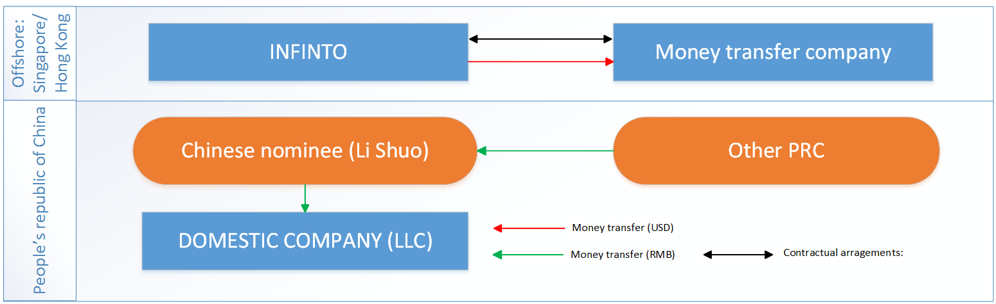
Appendix 1. List of proposed money-transfer companies
Queen Capital Finance (http://www.queencapitalfinance.com/about) – HK money lending company which provides money transferring service as well. Charges 100 USD per transaction as commission fee, exchange rate is close to official (range <1.5%). We have relationship with shareholder who assisted us with obtaining money lending license in Hong Kong.
Gold Mate Group (http://www.goldmategroup.com) – Australian money transferring company. Exchange rates are defined on transaction date, internal compliance audit passing is necessary
Step 1. Signing contract with money-transfer company (consulting agreement)
Step 2. Transferring certain amount of USD to money-transfer company’s account (for the consulting service)
Step 3. Receiving transfer of RMB to PRC individual (Li Shuo) personal account
Step 4. Transferring RMB from PRC individual bank’s account to LLC capital account
Such scheme is legal in Hong Kong or Australia, but is treating as illegal in China. Practically this is only one way to do cross-boarding transactions in restricted areas.

Slide 54
Appendix 2. List of banks we contacted about capital injection
# | Bank name | Comments
1 | “China Merchants Bank” | Recommended by “Fotic” as the bank who served “Home Credit” with similar scheme. Our request of capital transfer was rejected without any comments (Ander Rodionov, our Chinese business consulter was involved to this negotiations). Our legal Adviser Roger Hsieh informed us that “Home Credit” was punished for this activity.
2 | “China Constriction Bank” (CCB) | Recommended by Andrey Rodionov as a bank with big experience in cooperation with foreign companies. Our request was rejected without any comments. (Andery Rodionov was involved to this negotiations).
3 | ABC bank of China | Recommended by Li Shuo because of relationship with management. Our request was rejected with explanation of international department manager: purpose of usage for loans are being regulated as purpose of usage for registered capital for WFOE. It is prohibited to use this money for investment purpose. (Oleg Larin was involved to this negotiations).

Slide 55
Appendix 3. About “Fotic” trust company*
Founded on September 30, 1987, China Foreign Economy and Trade Trust Co., Ltd. (hereinafter referred to as FOTIC) is a subsidiary of Sinochem Group and engages in the trust business.
The shareholders of FOTIC are Sinochem Corporation (holds 96.22% of the shares) and Sinochem Finance Co., Ltd. (holds 3.78% of the shares), respectively. Sinochem has been on the list of the Fortune Global 500 for 24 times, ranking 107th in 2014. Sinochem is a state-owned company.
Fotic builds five major business segments: financial cooperation, securities, private investment and financing, wealth management and proprietary business.
In 2013 Fotic operating with trust asset size of approximate RMB320 bil ($48 bil)
Fotic obtained lending license (to provide loans to PRC individuals) and started cooperation with consumer finance companies in 2007 (with Home Credit), now Fotic is providing similar service to 30+ companies.
Fotic has all necessary infrastructure (disbursement/repayment, access to credit bureau, license) to companies who want to establish money-lending business in China
(*) http://en.fotic.com.cn/tabid/262/Default.aspx, http://en.fotic.com.cn/tabid/275/Default.aspx

Slide 56
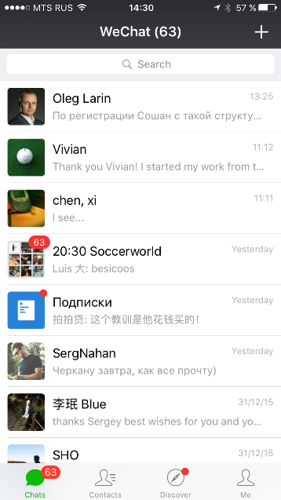
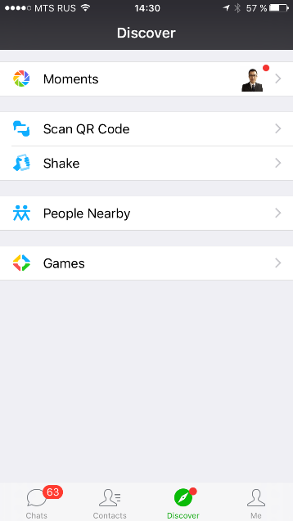
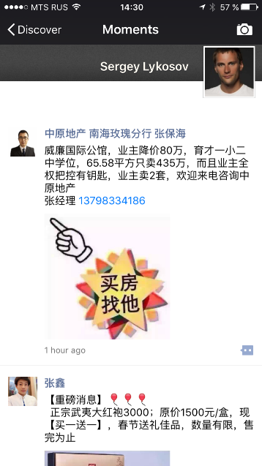
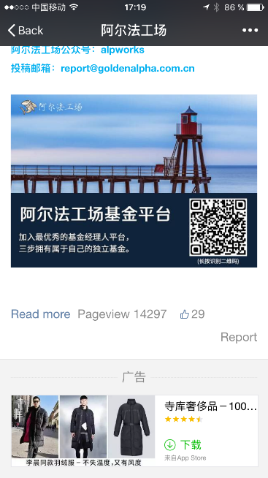
Appendix 4.1 WeChat advertisement: user story 1, moments
WeChat places advertisement in the official account’s articles footer. Customers could find this advertisement by different ways
Banner
Chats
Discover
Moments
Article
Moments – is analog for news line in Facebook. Chinese customers like to read articles from moments. Some articles are shared news from different official accounts. If customer read article from official accounts, WeChat adds an advertisement banner to the footer of the article.
Notes:
При низком показателе проникновения кредитных продуктов, основная их часть сосредоточена в сегменте SEC A и SEC B, при высоких требованиях к заемщику. Стратегия DCFC – всегда доступная финансовая поддержка рядом с клиентом посзволяет ориентироваться на 70% рынка.

Slide 57
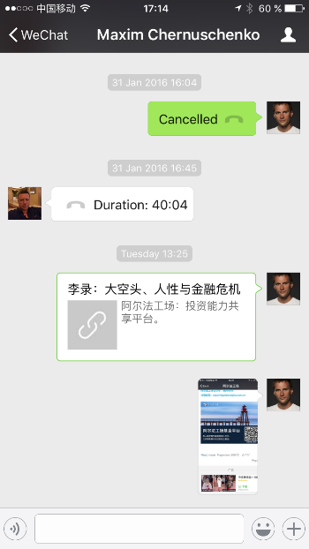
Appendix 4.2 WeChat advertisement: user story 2, chats
WeChat places advertisement in the official account’s articles footer. Customers could find this advertisement by different ways
Link to article
Banner
Chats
Chat with friend
Article
Customer sends to his friend link to the article via private chat. Customer’s friend open article and find advertisement in the footer.
Notes:
При низком показателе проникновения кредитных продуктов, основная их часть сосредоточена в сегменте SEC A и SEC B, при высоких требованиях к заемщику. Стратегия DCFC – всегда доступная финансовая поддержка рядом с клиентом посзволяет ориентироваться на 70% рынка.

Slide 58
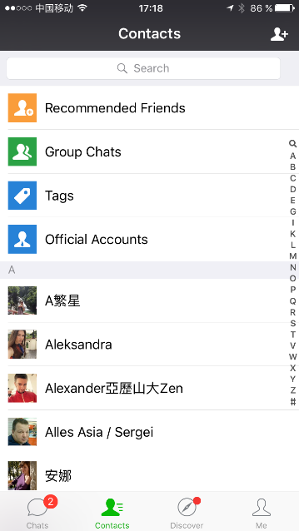
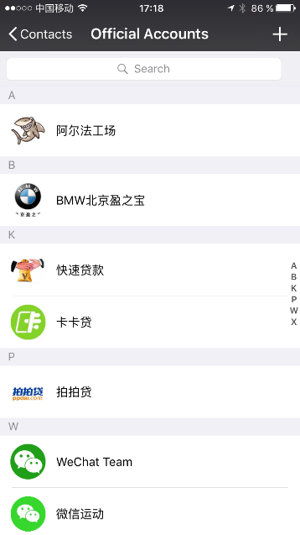
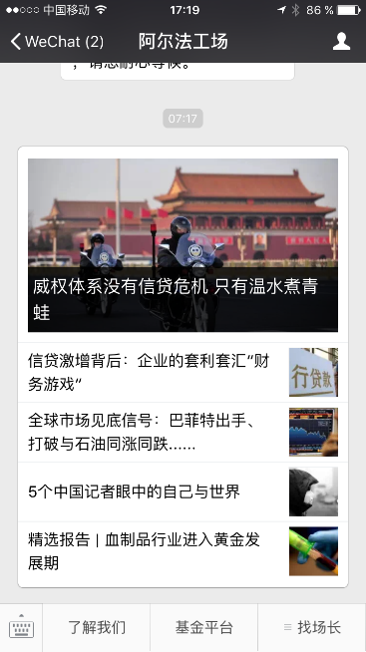
Appendix 4.3 WeChat advertisement: user story 3, subsc.
WeChat places advertisement in the official account’s articles footer. Customers could find this advertisement by different ways
Banner
Chats
Contacts
Official accounts
OA newsline
Article
Customer explores his subscriptions, open official account, open and read the article and find advertisement in the footer.
Notes:
При низком показателе проникновения кредитных продуктов, основная их часть сосредоточена в сегменте SEC A и SEC B, при высоких требованиях к заемщику. Стратегия DCFC – всегда доступная финансовая поддержка рядом с клиентом посзволяет ориентироваться на 70% рынка.

Slide 59
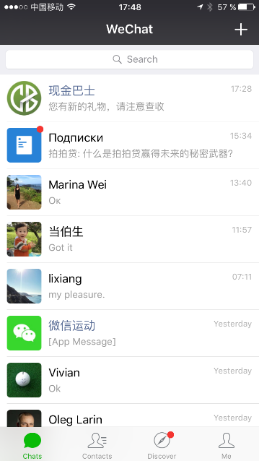
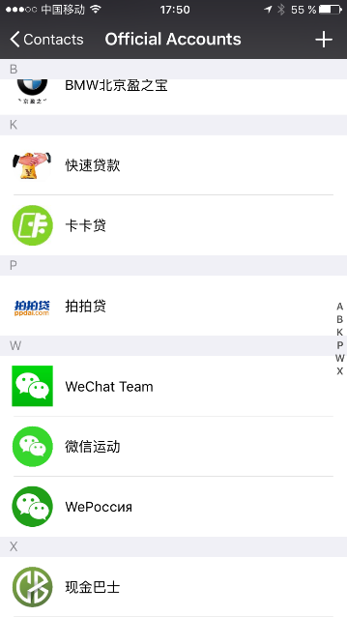
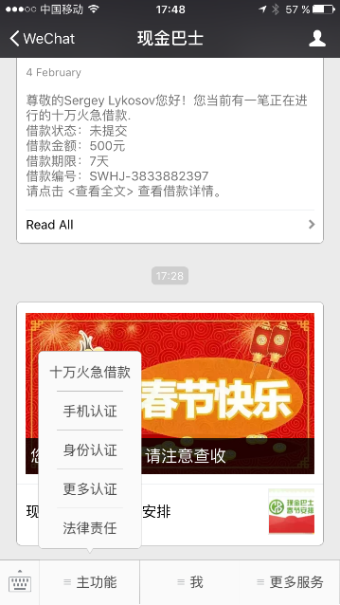

Appendix 4.4 Applying via WeChat
Chats or Official accounts list
Interactive menu
Application form
Customers could apply for a loan via WeChat internal application. Customer need only to click ‘follow’ to add your application in his store. After customer followed official account owned could send him messages.
Notes:
При низком показателе проникновения кредитных продуктов, основная их часть сосредоточена в сегменте SEC A и SEC B, при высоких требованиях к заемщику. Стратегия DCFC – всегда доступная финансовая поддержка рядом с клиентом посзволяет ориентироваться на 70% рынка.

Slide 60
Appendix 5.1 CN orgchart (as of now)
All employees will be located in the same office during startup period

Slide 61
Appendix 5.2 Target orgchart as of EOY2018
We can have relative few amount of managers due to sharing resources of RH
We will relocate call center to suburban area of Shenzhen, this could help us to save around 40% of rent cost and 15% of salary cost from year 3
Organization chart for years 2019-2021 will be developed in 2018, however we do not expect growing of managers, only number of staff will grow according number of operations

Slide 62
Appendix 5.3 Headcount and Personnel budget
Group/Position | Gross costs of employment, USD | Headcount |  |  |  |  |  | Monthly cost of employment, USD
 |  | At present | EOY 1 | EOY 2 | EOY 3 | EOY 4 | EOY 5 | At present | EOY 1 | EOY 2 | EOY 3 | EOY 4 | EOY 5
Total staff (fixed+variable) |  | 10 | 102 | 254 | 377 | 442 | 448 | 51 943 | 212 652 | 451 463 | 540 913 | 610 457 | 617 524
Total fixed staff |  | 7 | 16 | 26 | 26 | 26 | 26 | 48 312 | 100 160 | 156 605 | 156 605 | 156 605 | 156 605
Mangement and direct reports |  | 2 | 4 | 6 | 6 | 6 | 6 | 13 393 | 18 772 | 37 982 | 37 982 | 37 982 | 37 982
Country Manager | 10 000 | 1 | 1 | 1 | 1 | 1 | 1 | 10 000 | 10 000 | 10 000 | 10 000 | 10 000 | 10 000
CEO | 15 687 |  | 0 | 1 | 1 | 1 | 1 | 0 | 0 | 15 687 | 15 687 | 15 687 | 15 687
Business assistant | 3 393 | 1 | 1 | 1 | 1 | 1 | 1 | 3 393 | 3 393 | 3 393 | 3 393 | 3 393 | 3 393
Quality control manager | 3 643 |  | 1 | 1 | 1 | 1 | 1 | 0 | 3 643 | 3 643 | 3 643 | 3 643 | 3 643
Business development manager | 3 523 |  | 0 | 1 | 1 | 1 | 1 | 0 | 0 | 3 523 | 3 523 | 3 523 | 3 523
Translator/office assistant | 1 736 |  | 1 | 1 | 1 | 1 | 1 | 0 | 1 736 | 1 736 | 1 736 | 1 736 | 1 736
Operations department |  | 0 | 1 | 1 | 1 | 1 | 1 | 0 | 13 687 | 13 687 | 13 687 | 13 687 | 13 687
Chief Operational Officer | 13 687 |  | 1 | 1 | 1 | 1 | 1 | 0 | 13 687 | 13 687 | 13 687 | 13 687 | 13 687
Risk department |  | 1 | 2 | 5 | 5 | 5 | 5 | 8 187 | 21 873 | 36 730 | 36 730 | 36 730 | 36 730
Chief Risk Officer | 13 687 |  | 1 | 1 | 1 | 1 | 1 | 0 | 13 687 | 13 687 | 13 687 | 13 687 | 13 687
Credit Strategy Manager | 8 187 | 1 | 1 | 1 | 1 | 1 | 1 | 8 187 | 8 187 | 8 187 | 8 187 | 8 187 | 8 187
Risk manager | 4 585 |  | 0 | 1 | 1 | 1 | 1 | 0 | 0 | 4 585 | 4 585 | 4 585 | 4 585
Anti fraud manager | 5 687 |  | 0 | 1 | 1 | 1 | 1 | 0 | 0 | 5 687 | 5 687 | 5 687 | 5 687
Operational risk manager | 4 585 |  | 0 | 1 | 1 | 1 | 1 | 0 | 0 | 4 585 | 4 585 | 4 585 | 4 585
Financial department |  | 1 | 4 | 5 | 5 | 5 | 5 | 13 687 | 22 996 | 26 519 | 26 519 | 26 519 | 26 519
Chief financial officer | 13 687 | 1 | 1 | 1 | 1 | 1 | 1 | 13 687 | 13 687 | 13 687 | 13 687 | 13 687 | 13 687
Accountant/financial manager | 3 523 |  | 1 | 1 | 1 | 1 | 1 | 0 | 3 523 | 3 523 | 3 523 | 3 523 | 3 523
Reporting manager | 4 050 |  | 1 | 1 | 1 | 1 | 1 | 0 | 4 050 | 4 050 | 4 050 | 4 050 | 4 050
Finance Specialist | 1 736 |  | 1 | 1 | 1 | 1 | 1 | 0 | 1 736 | 1 736 | 1 736 | 1 736 | 1 736
Disbursement/repayment manager | 3 523 |  | 0 | 1 | 1 | 1 | 1 | 0 | 0 | 3 523 | 3 523 | 3 523 | 3 523
Digital marketing department |  | 1 | 2 | 3 | 3 | 3 | 3 | 3 000 | 9 393 | 12 786 | 12 786 | 12 786 | 12 786
Digital marketing manager | 6 393 |  | 1 | 1 | 1 | 1 | 1 | 0 | 6 393 | 6 393 | 6 393 | 6 393 | 6 393
Juniour digital marketing manager | 3 000 | 1 | 1 | 1 | 1 | 1 | 1 | 3 000 | 3 000 | 3 000 | 3 000 | 3 000 | 3 000
Marketing manager | 3 393 |  | 0 | 1 | 1 | 1 | 1 | 0 | 0 | 3 393 | 3 393 | 3 393 | 3 393
IT department |  | 1 | 1 | 1 | 1 | 1 | 1 | 4 523 | 4 523 | 4 523 | 4 523 | 4 523 | 4 523
IT Manager | 4 523 | 1 | 1 | 1 | 1 | 1 | 1 | 4 523 | 4 523 | 4 523 | 4 523 | 4 523 | 4 523
Legal department |  | 0 | 1 | 2 | 2 | 2 | 2 | 0 | 3 393 | 15 079 | 15 079 | 15 079 | 15 079
Chief Legal Officer | 11 687 |  | 0 | 1 | 1 | 1 | 1 | 0 | 0 | 11 687 | 11 687 | 11 687 | 11 687
Legal manager | 3 393 |  | 1 | 1 | 1 | 1 | 1 | 0 | 3 393 | 3 393 | 3 393 | 3 393 | 3 393
HR department |  | 1 | 1 | 3 | 3 | 3 | 3 | 5 523 | 5 523 | 9 300 | 9 300 | 9 300 | 9 300
HR Director | 5 523 | 1 | 1 | 1 | 1 | 1 | 1 | 5 523 | 5 523 | 5 523 | 5 523 | 5 523 | 5 523
Recruiter | 1 888 |  | 0 | 1 | 1 | 1 | 1 | 0 | 0 | 1 888 | 1 888 | 1 888 | 1 888
Personal admin&payroll specialist | 1 888 |  | 0 | 1 | 1 | 1 | 1 | 0 | 0 | 1 888 | 1 888 | 1 888 | 1 888
Total variable staff |  | 3 | 86 | 228 | 351 | 416 | 422 | 3 631 | 112 492 | 294 858 | 384 307 | 453 852 | 460 918
Operations department |  | 2 | 39 | 96 | 133 | 132 | 134 | 2 420 | 52 457 | 125 646 | 147 542 | 145 619 | 148 570
Verificator Teamleader | 2 262 |  | 1 | 3 | 3 | 2 | 2 | 0 | 2 262 | 6 787 | 5 769 | 3 846 | 3 846
Verificator | 1 210 | 1 | 14 | 31 | 39 | 30 | 30 | 1 210 | 16 942 | 37 515 | 40 117 | 30 859 | 30 859
Telesale operators Supervisor | 2 262 |  | 1 | 1 | 1 | 1 | 1 | 0 | 2 262 | 2 262 | 1 923 | 1 923 | 1 923
Telesale operators Teamleader | 2 262 |  | 1 | 2 | 3 | 3 | 3 | 0 | 2 262 | 4 525 | 5 769 | 5 769 | 5 769
Telesale operators | 1 210 |  | 10 | 28 | 36 | 31 | 31 | 0 | 12 102 | 33 885 | 37 031 | 31 888 | 31 888
Customer support Supervisor | 2 262 |  | 1 | 1 | 1 | 1 | 1 | 0 | 2 262 | 2 262 | 1 923 | 1 923 | 1 923
Customer support Teamleader | 2 262 |  | 1 | 2 | 4 | 4 | 5 | 0 | 2 262 | 4 525 | 7 692 | 7 692 | 9 615
Customer support | 1 210 | 1 | 10 | 28 | 46 | 60 | 61 | 1 210 | 12 102 | 33 885 | 47 318 | 61 719 | 62 747
Risk department |  | 1 | 47 | 132 | 218 | 284 | 288 | 1 210 | 60 035 | 169 212 | 236 765 | 308 233 | 312 348
Telecollector Teamleader | 2 262 |  | 3 | 9 | 14 | 18 | 18 | 0 | 6 787 | 20 361 | 26 922 | 34 614 | 34 614
Telecollector | 1 210 | 1 | 44 | 123 | 204 | 266 | 270 | 1 210 | 53 247 | 148 851 | 209 843 | 273 619 | 277 734

Slide 63
Appendix 6. CN Product parameters
# | Parameter |  | BASIC Description |  | CN Value "PDL" (28.07.16) | CN Description "PDL" (28.07.16) | CN Comments "PDL" (28.07.16)
1 | Type of the loan |  | Pay-day-loan (Cash loan with 1 repayment). |  |  | Pay-day-loan (Cash loan with 1 repayment).
2 | Loan amount (LA) |  | Absolute amount in appropriate currency. |  | Range 500-2000 RMB (500, 1000, 1500, 2000) | Absolute amount in appropriate currency.
3 | Loan tenor (LT) |  | Absolute amount in calendar days. Time period, after expiring of which the loan should be fully repaid or prolonged. |  | 7, 15, 21 or 30 calendar days | Absolute amount in calendar days. Time period, after expiring of which the loan should be fully repaid or prolonged.
4 | Interest rate | Calculation rules | Calculated as a percent of unpaid principal. Interest is calculated at the end of every calendar day during the whole LT of using the loan. Interest calculation for the first day of using the loan should be done immediately after loan granting. Interest calculation for the second or further days of using the loan should be done at second or appropriate day's closure. Interest calculation for the last day of using the loan should be done at day's closure, prior to the Payday day. |  | 0.05% per day | Calculated as a percent of unpaid principal. Interest is calculated at the end of every calendar day during the whole LT of using the loan. Interest calculation should be done at appropriate day's closure. | ~<18% per annum interest rate is to comply with 18% per annum CN interest cap regulation. In TS standard calculation rules should be used.
 |  | Charging rules | Charged immediately after calculating. |  | - | Charged immediately after calculating. | -
 |  | Due date | The last day of the LT (Payday). |  | - | The last day of the LT (Payday). | -
 |  | Repayment rules | Repaid by customer's payment. Partial repayment сan be allowed or not allowed according to the product parameters. |  | Allowed | Repaid by customer's payment. Partial repayment сan be allowed or not allowed according to the product parameters. | -
 |  | Special features | The interest rate can be decreased after successful loan repayment - for every new loan by certain constant value up to the defined min.value. The feature can activated or disabled according to the product parameters. |  |  | -
5 | Overdue interest rate | Calculation rules | Calculated as a percent of the unpaid principal. Overdue interest is calculated at the end of every calendar day during the whole period of delinquency. |  | 1,5% per day | Calculated as a percent of the unpaid principal. Overdue interest is calculated at the end of every calendar day during the whole period of delinquency.
 |  | Charging rules | Charged immediately after calculating, but starting from certain day of the continious delinquency. If starting date differs from the first day of delinquency appearance - all the accrued postponed Overdue interest will be charged at starting day. Maximum length of the uninterupted period of Overdue interest charging is limited according to certain parameter. Overdue interest is not charged if full debt (including prinicipal and all the fees and interest accrued) is less than certain absolute amount. |  | Charged only if the delinquency continously lasts more than 3 calendar days and the full debt exceeds 10 RMB for max.60 calendar days. | Charged immediately after calculating, but starting from certain day of the continious delinquency. If starting date differs from the first day of delinquency appearance - all the accrued postponed Overdue interest will be charged at starting day. Maximum length of the uninterupted period of Overdue interest charging is limited according to certain parameter. Overdue interest is not charged if full debt (including prinicipal and all the fees and interest accrued) is less than certain absolute amount.
 |  | Due date | Immediately after charging. |  | - | Immediately after charging. | -
 |  | Repayment rules | Repaid by customer's payment. Partial repayment сan be allowed or not allowed according to the product parameters. |  | Allowed | Repaid by customer's payment. Partial repayment сan be allowed or not allowed according to the product parameters. | -
6 | Service Fee | Calculation rules | Calculated as a certain percent of the whole unpaid principal or for every day of appropriate LT as a one-time fee for the whole LT or prolonged period (in this case it is calculated basing on unpaid principal at the moment of obtaining Prolongation). Calculated immediately after loan granting or obtaining prolongation. |  | 0,95% per day. | Calculated as a certain percent of the unpaid principal for every day of appropriate LT or prolonged period. Calculation should be done at appropriate day's closure. | In TS standard calculation rules (including waving a part of the fee in case of full early loan repayment according to the proportion of the actual time of using the loan to the planned LT) should be used.
 |  | Charging rules | Charged immediately after calculating. |  | - | Charged immediately after calculating. | -
 |  | Due date | The last day of the appropriate LT (Payday), for which it was charged. |  | The last day of the LT (Payday) within which it was charged. | The last day of the appropriate LT (Payday), for which it was charged. | -
 |  | Repayment rules | Repaid by customer's payment. Partial repayment сan be allowed or not allowed according to the product parameters. |  | Allowed | Repaid by customer's payment. Partial repayment сan be allowed or not allowed according to the product parameters. | -
7 | Early loan repayment feature | Essence | Possibility to partially or fully repay the loan before the Payday. |  | - | Possibility to partially or fully repay the loan before the Payday. | -
 |  | Partial repayment possibility | Can be allowed or not allowed according to the product parameters. |  | Allowed at any time | -
 |  | Partial repayment rules | During the initial LT - allowed after at least a half of the initial LT will pass, but not earlier than after passing of certain calendar days. During the prolonged LT - allowed at any time. |  | - | -
 |  | Full repayment possibility | Can be allowed or not allowed according to the product parameters. |  | Allowed at any time | -
 |  | Full repayment rules | During the initial LT - allowed after at least a half of the initial LT will pass, but not earlier than after passing of certain calendar days. During the prolonged LT - allowed at any time. |  | - | -
8 | Early loan repayment fee (ERF) | Calculation rules | Calculated as a certain % of the unpaid principal (as it was on the previous to the full repayment calendar day) or absolute amount as a one-time fee. |  | 50 RMB | Calculated as a certain % of the unpaid principal (as it was on the previous to the full repayment calendar day) or absolute amount as a one-time fee. | -
 |  | Charging rules | One-time fee charged in case of committing full early loan repayment within the certain number of calendar days after obtaining the loan and before the Payday. |  | Charged only if full early loan repayment is done within the first 6 days of using the loan. | One-time fee charged in case of committing full early loan repayment within the certain number of calendar days after obtaining the loan and before the Payday. | -
 |  | Due date | Immediately after charging. |  | - | Immediately after charging. | -
 |  | Repayment rules | Repaid by customer's payment. Partial repayment сan be allowed or not allowed according to the product parameters. |  | Allowed | Repaid by customer's payment. Partial repayment сan be allowed or not allowed according to the product parameters. | -
9 | Late payment fee (LPF) | Calculation rules | Calculated as a certain absolute amount. |  | 10 RMB | Calculated as a certain absolute amount. | If the payday is 15.07 and by the end of the day 18.07 appropriate repayment (enough for full loan repayment or obtaining prolongation) haven't been paid, there will be RMB 10 charged.
 |  | Charging rules | Charged in case of committing delinquency within the certain continous number of calendar days after the Payday for every LT. First time LPF is charged after the certain number of calendar days after the Payday will pass. Second/further times LPF will be charged after the certain number of calendar days after the Payday+LT will pass. Maximum number of continious chargings of LPF is limited according to certain parameter. LPF is not charged if the full debt (including prinicipal and all the fees and interest accrued) is less than certain absolute amount. |  | Charged in case of committing delinquency continiously within 3 calendar days. 2 continious chargings allowed. Full debt should be more than 10 RMB | Charged in case of committing delinquency and staying in delinquency for a long time. First time LPF is charged after the certain number of calendar days after the Payday will pass. Second/further times LPF will be charged every 30 calendar days after the Payday. Maximum number of continious chargings of LPF is limited according to certain parameter. LPF is not charged if the full debt (including prinicipal and all the fees and interest accrued) is less than certain absolute amount. | If the payday is 15.07 and there will be no any repayments at 18.07 day's closure, LPF will be charged first time; at 14.08 day's closure LPF will be charged second time; further no more consecutive LPFs will be charged.
 |  | Due date | Immediately after charging. |  | - | Immediately after charging. | -
 |  | Repayment rules | Repaid by customer's payment. Partial repayment сan be allowed or not allowed according to the product parameters. |  | Allowed | Repaid by customer's payment. Partial repayment сan be allowed or not allowed according to the product parameters. | -
10 | Prolongation feature | Essence | Prolonging the loan on Payday for another period of time equal to certain length (till prolonged Payday). First prolongation can be obtained within the period of time equal to the initial LT starting from the initial Payday. Further prolongations can be obtained within the period of time equal to the standard prolongation length starting from the prolonged Payday. Maximum number of prolongations to be granted is limited. |  | Standard prolongation length is 30 calendar days. Max.6 prolongations can be done. | Prolonging the loan on Payday for another period of time equal to certain length (till prolonged Payday). Prolongation can be obtained within 30 calendar days starting from the Payday. Maximum number of prolongations to be granted is limited. In case of meeting the conditions of obtaining Prolongation in the period of delinquency, the Prolongation starts from the date of satisfying condition of the Prolongation. | If the Payday is 15.08 and the Full payment = 1000 loan + 15 (1.497% interest for 30 days) + 285 (service fee for 30 days) = 1300 (number to be rounded up), but the customer can pay >300 on 15.08 - he'll meet the conditions of obtaining Prolongation and get the Prolongation for 30days starting from the day of making appropriate payment.
 |  | Prolongation possibility | Can be allowed or not allowed according to the product parameters. |  | Allowed | Can be allowed or not allowed according to the product parameters. | -
 |  | Prolongation rules | Prolongation can be obtained on condition of partial loan repayment, enough to cover all the interest, overdue interest and fees accrued and due to be paid. Prolongation can be obtained if the partial underpayment is less than certain absolute amount. |  | - | Prolongation can be obtained on condition of partial loan repayment, enough to cover all the interest, overdue interest and fees accrued and due to be paid. Prolongation can be obtained if the partial underpayment is less than certain absolute amount. | -
11 | Prolongation fee | Calculation rules | Calculated as a certain absolute amount or percent of the unpaid principal. |  | 0 | Calculated as a certain absolute amount or percent of the unpaid principal.
 |  | Charging rules | Charged immediately after obtaining prolongation service. |  | - | Charged immediately after obtaining prolongation service.
 |  | Due date | New (prolonged) Payday. |  | - | New (prolonged) Payday.
 |  | Repayment rules | Repaid by customer's payment. Partial repayment is allowed. |  | Allowed | Repaid by customer's payment. Partial repayment is allowed.
12 | Repayment hierarchy | - | Defined by appropriate product parameters. |  | 1. Overdue interest rate 2. Interest rate 3. Early repayment fee 4. Service fee 5. Consulting Fee 6. Handling Fee 7. Prolongation fee (due) 8. Principal 9. Late payment fee
13 | "First loan for free" feature | Essence | For the first loan interest rate and fees will not be charged within the initial LT. |  | - | For the first loan interest rate and fees will not be charged within the initial LT.
 |  | Possibility | Can be allowed or not allowed according to the product parameters. |  | Available (Disabled) | Can be allowed or not allowed according to the product parameters.
 |  | Rules | First loan must be of certain LT and LA. In case of delinquency or prolongation interest rates and fees will be charged starting from the Payday according to standard product parameters. |  | Applicable only for loans with max.30 days LT and max.1000 RMB LA. | First loan must be of certain LT and LA. In case of delinquency or prolongation interest rates and fees will be charged starting from the Payday according to standard product parameters. | Parameters must vary.
14 | Handling fee | Calculation rules | Calculated as a certain percent of the unpaid principal for the whole or every day of appropriate LT as a one-time fee for the whole LT. Calculated immediately after loan granting or obtaining prolongation. |  | 0 RMB | Calculated as a certain absolute amount. Calculated immediately after loan granting or obtaining prolongation.
 |  | Charging rules | Charged immediately after it's calculation. |  | - | Charged immediately after it's calculation.
 |  | Due date | Immediately after loan granting |  | - | Immediately after loan granting
 |  | Repayment rules | Repaid by loan amount. Partial repayment is allowed. |  | Allowed | Repaid by loan amount for initial loan tenor. For prolongation Repaid by customer's payment Partial repayment is allowed.
15 | Consulting Fee | Calculation rules | Calculated as a certain percent of the unpaid principal for every day of appropriate LT as a one-time fee for the whole LT. Calculated immediately after loan granting or obtaining prolongation. |  | 0% per day. | Calculated as a certain percent of the unpaid principal for every day of appropriate LT as a one-time fee for the whole LT. Calculated immediately after loan granting or obtaining prolongation.
 |  | Charging rules | Charged immediately after calculating. |  | - | Charged immediately after calculating.
 |  | Due date | The last day of the appropriate LT (Payday), for which it was charged. |  | - | The last day of the appropriate LT (Payday), for which it was charged.
 |  | Repayment rules | Repaid by customer's payment. Partial repayment сan be allowed or not allowed according to the product parameters. |  | - | Repaid by customer's payment. Partial repayment сan be allowed or not allowed according to the product parameters.
16 | Autocontract closure feature | Essence | Autoclosing the contract by waiving unpaid principal during the day's closure. |  | - | Autoclosing the contract by waiving unpaid principal during the day's closure.
 |  | Autoclosure possibility | Can be allowed or not allowed according to the product parameters. |  | Allowed | Can be allowed or not allowed according to the product parameters.
 |  | Autoclosure rules | Autoclosure can be done if unpaid principal at the day's closure is not exceeding certain amount. |  | - | Autoclosure can be done if unpaid principal at the day's closure doesn't exceed 10 RMB | -

